Slide 1
Anaesthesia Considerations for Adult Traumatic Brain Injury
By wubayehu amare ( MSC, lecturer)

Slide 2
Outline
Define TBI
Epidemiology
Types of head injury
Primary and secondary head injury
Management consideration
Anesthetic techniques

Slide 3
Introduction
Traumatic Brain Injury (TBI) is a critical medical condition that results from an external force causing injury to the brain.
It is a leading cause of death and disability globally, with significant morbidity and long-term complications.
Anesthesia management in TBI patients is crucial because of the potential for rapid deterioration and the delicate balance required to maintain cerebral perfusion and prevent secondary brain injury

Slide 4
Traumatic brain injury (TBI) is an acquired insult to the brain due to an external mechanical force and can lead to transient or permanent impairment of cognitive, physical, and psychosocial functions.
CNS trauma consists of both the;-
Primary injury, in which tissue is disrupted by mechanical force, and
Secondary response, in which the body’s reaction to the injury plays an important role

Slide 5
Cont…
Any trauma patient with an altered level of consciousness must be considered to have a traumatic brain injury (TBI) until proven otherwise.
Presence or suspicion of TBI mandates attention to maintaining cerebral perfusion pressure and oxygenation during all aspects of care.
The most reliable clinical assessment tool in determining the significance of TBI in a non-sedated, non-paralyzed patient is the Glasgow Coma Scale.

Slide 6
Cont…
Mitigation of secondary CNS injury depends on prompt diagnosis and early, goal directed therapy.
Primary CNS injuries can’t be minimized other than preventive strategies.
Secondary injury account for much of deaths and disability that follow the trauma
Attention to the ABCDE approach is paramount to successful resuscitation, and the trauma anesthesiologist should be intimately involved in this process.

Slide 7
Cont….
Anesthetist are most often involved in the care of patients with moderate to severe TBI for a variety of procedures including but not limited to
Initial evaluation and resuscitation,
Diagnostic imaging,
Surgical intervention, and
Intensive care unit (ICU) management.

Slide 8
Causes of TBI
Common Causes:
Road Traffic Accidents (RTAs): Major cause, especially in low-income countries.
Falls: Especially in elderly and children.
Violence & Assaults: Including gunshot wounds, physical assault.
Sports Injuries: Contact sports, falls during physical activity.

Slide 9
Cont….
The leading cause of TBI-related death varies by age:
Falls are the major cause of death for elderly persons (age>65).
MVCs are responsible for the majority of deaths in children and young adults (ages 5–24).
Assaults are the leading cause of death for children (ages 0–4).
Male gender is associated with a higher rate of hospitalization as well as a three-fold increase in death from TBI.

Slide 10
TBI in Ethiopia
Road Traffic Accidents:
A major cause of TBI, accounting for up to 40% of trauma admissions.
High incidence of motorbike-related injuries.
TBI Care in Ethiopia:
Limited neurosurgical services, particularly in rural areas.
Shortage of CT scanners and advanced monitoring equipment.
High mortality in severe TBI cases due to late presentation and lack of resources.
Healthcare System:
Major hospitals in Addis Ababa have specialized trauma and neurosurgical care, but rural areas lack access.

Slide 11
TBI Classification
Traumatic Brain Injury (TBI) is classified based on severity, mechanism, and location of injury.
Each classification helps guide clinical management and predict outcomes.
Understanding these classifications is crucial for both immediate care and long-term prognosis, especially in resource-limited settings where early identification and intervention are key.

Slide 12
1. Severity Classification of TBI
The severity of a TBI is usually assessed using the GCS,
which is a clinical tool used to evaluate the LOC based on three parameters: eye opening, verbal response, and motor response.
The GCS score helps categorize the injury as
Mild
Moderate
Severe, with higher scores indicating less severe brain injury.

Slide 13
Mild TBI (GCS 13-15)
Concussion: This is the most common form of TBI.
A concussion often results from a blow to the head or a jolt, and may or may not involve a brief loss of consciousness (LOC).
GCS Score: 13-15, indicating mild impairment of consciousness. Patients are typically oriented and able to respond to verbal commands.
Symptoms:
Brief loss of consciousness (if present).
Confusion, headache, dizziness, blurred vision, nausea.

Slide 14
Cont…
Symptoms may resolve within minutes to hours, but some individuals may experience post-concussion syndrome, including headaches, dizziness, fatigue, and cognitive impairments.
Management:
Close monitoring for a few hours to ensure symptoms resolve.
Imaging (CT or MRI) may not be required unless there are signs of more severe injury.
Return-to-activity guidelines are important, especially in sports-related concussions.

Slide 15
Moderate TBI (GCS 9-12):
Increased Injury: Moderate TBIs are associated with more pronounced impairments and require more intensive monitoring and management.
GCS Score: 9-12, reflecting a moderate decrease in consciousness. Patients may be confused and may have difficulty following commands.
Symptoms:
Confusion, agitation, or drowsiness that may last for hours.
Memory deficits, impaired cognition, and sometimes, physical impairment such as weakness or numbness.

Slide 16
Cont….
Possible focal neurological signs, such as speech difficulties or paralysis.
Management:
Requires more aggressive monitoring, including imaging (CT scan or MRI) to assess for intracranial bleeding or structural damage.
ICP monitoring may be necessary if there is concern for increased intracranial pressure.
Neurological assessments to determine the extent of cognitive impairment.
Management of airway, ventilation, and hemodynamics as necessary.

Slide 17
Severe TBI (GCS 3-8)
Critical Injury: Severe TBI represents significant brain injury that may lead to coma or even brain death if not managed appropriately. This group requires immediate, intensive care.
GCS Score: 3-8, with the patient potentially being unresponsive or only responding to painful stimuli. A GCS of 3 indicates deep coma or brain death.
Symptoms:
Loss of consciousness for an extended period (minutes to days).

Slide 18
Cont..
Severe neurological deficits, including significant motor and sensory impairments, possibly including paralysis, speech deficits, or loss of vision.
May have abnormal pupil responses, loss of brainstem reflexes, and may require mechanical ventilation
Management:
Urgent Interventions: Immediate airway management and mechanical ventilation are often required.
ICU Admission: Close monitoring in the ICU with continuous ICP monitoring and frequent neurological assessments.

Slide 19
Cont..
Imaging: Emergency CT or MRI to identify any bleeding, swelling, or brain shift.
Multidisciplinary Care: Neurosurgery, neurocritical care, and rehabilitation specialists are often required for long-term care.
Surgical Intervention: If hemorrhages, contusions, or other life-threatening lesions are identified, surgical intervention may be needed

Slide 20
2. Mechanism of Injury in TBI
The mechanism of injury describes how the injury occurs and plays a significant role in determining the severity and type of TBI.
Closed Head Injury (Non-Penetrating)
Definition: A closed head injury occurs when there is no break in the skull. The brain is still contained within the skull, but can be damaged due to forces such as acceleration-deceleration, impact, or rotational forces.

Slide 21
Types of Closed Head Injury
Concussion: A temporary alteration in brain function that usually resolves with time but can have long-term effects, especially in repetitive injuries.
Contusion: Bruising of the brain tissue, typically seen at the site of impact.
Diffuse Axonal Injury (DAI): Injury to the brain's axons, often caused by rotational forces that stretch and damage the axons, leading to widespread brain dysfunction.

Slide 22
Open/Penetrating Head Injury
Definition: Occurs when an object penetrates the skull and enters the brain tissue, causing focal damage to the brain.
Causes: Gunshot wounds, stabbing, or sharp force trauma.
Characteristics:
Skull Fracture: A break in the bone, which can be simple or complex (e.g., depressed skull fractures).
Penetrating Injury: An object (e.g., bullet, knife) enters the skull and potentially damages the underlying brain tissue.

Slide 23
Cont..
Risk: High risk of infection, bleeding, and direct brain damage. Can be associated with high mortality, particularly if the injury involves vital structures like the brainstem.

Slide 24
3. Location of Injury in TBI
The location of the brain injury directly impacts the patient’s symptoms, prognosis, and management strategy.
The brain's functional areas are divided into different regions, and injury to specific areas can lead to characteristic neurological deficits.

Slide 25
Cerebral Contusions
Definition: A contusion is a bruise on the brain caused by impact with the skull or a direct blow.
It results in small blood vessels breaking and bleeding into the brain tissue, leading to localized swelling and damage.
Common Sites:
Frontal Lobes: Often affected due to the brain’s movement inside the skull during impact.
Temporal Lobes: Can also be involved, especially in high-impact or rotational injuries.

Slide 26
Cont..
Symptoms: May include confusion, headache, cognitive impairments, and motor deficits depending on the region affected. In severe cases, it can lead to loss of consciousness or coma.

Slide 27
Diffuse Axonal Injury (DAI)
Definition: DAI is a type of injury where the brain’s long nerve fibers (axons) are stretched or torn, typically due to acceleration-deceleration forces (e.g., whiplash injuries or high-speed motor vehicle accidents).
Mechanism: Often caused by rapid deceleration, such as a car crash or sports injury.
Symptoms: Immediate loss of consciousness, coma, or a persistent vegetative state. It is often associated with significant cognitive and physical impairments

Slide 28
Cont…
DAI is one of the leading causes of long-term disability and is difficult to detect on standard CT scans (MRI may be more sensitive).

Slide 29
Hemorrhages in TBI
Hemorrhages (bleeding) inside the brain can occur as a result of injury to blood vessels.
The location and type of hemorrhage are critical in determining the severity of the TBI and the required interventions.
Epidural Hematoma
Subdural Hematoma
Intracerebral Hemorrhage (ICH)

Slide 30
Epidural Hematoma (EDH)
Epidural Hematoma (EDH) is a potentially life-threatening condition resulting from trauma that causes bleeding between the dura mater and the skull.
It is often associated with a tear in the middle meningeal artery or other blood vessels, leading to accumulation of blood within this space.
The rapid accumulation of blood can increase intracranial pressure (ICP), which, if left untreated, may lead to brain herniation and death.

Slide 31
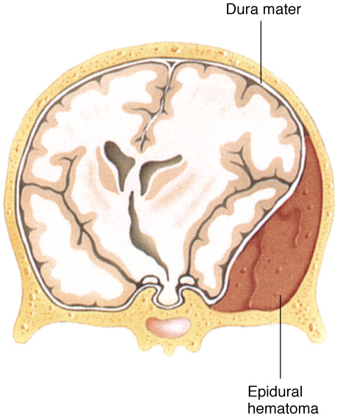
Cont..
Cause of Epidural Hematoma
The most common cause of an epidural hematoma is head trauma, particularly blunt force trauma such as:
Motor vehicle accidents (MVA
Falls: Especially in elderly individuals or those with a history of alcoholism (increased fall risk).
Sports injuries:
Assault:

Slide 32
Pathophysiological Mechanism
Tear in the Middle Meningeal Artery: This is the most common cause of an epidural hematoma.
The middle meningeal artery runs in the temporal region of the skull, and direct trauma to the temporal bone can result in a fracture that lacerates the artery.
Venous Bleeding: While arterial bleeding is more common, venous hemorrhage can also occur, usually from torn dural sinuses or bridging veins.

Slide 33
Symptoms of Epidural Hematoma
1. Initial Loss of Consciousness:
Immediate LOC following trauma is common.
Duration: (brief LOC) minutes to seconds.
2. Lucid Interval:
After regaining consciousness, the patient may appear to be fully conscious and oriented, and this period is often referred to as the "lucid interval."
The patient may seem to recover completely for a period of time (minutes to hours), but as the hematoma continues to expand, symptoms worsen.

Slide 34
Cont..
3. Neurological Deterioration:
The lucid interval is followed by a progressive deterioration in neurological status as the hematoma enlarges, compressing the brain and increasing ICP.
Signs of increased ICP:
Headache: Severe, often accompanied by nausea and vomiting.
Confusion, agitation.
Hemiparesis or focal neurological deficits.
Pupillary changes: Unequal pupils (anisocoria) or fixed, dilated pupils, especially on the side of the hematoma.
Altered level of consciousness: From drowsiness to coma.
Notes:
A lucid interval followed by deterioration of neurological function is a hallmark feature

Slide 35
Cont…
Clinical Features of Brain Herniation:
If the hematoma continues to expand and ICP rises significantly, brain herniation may occur, which can lead to:
Cushing's reflex: Increased systolic blood pressure, bradycardia, and irregular respirations (sign of impending herniation).
Fixed and dilated pupils.
Posturing (decerebrate or decorticate posturing).
Respiratory arrest: As herniation compresses the brainstem.

Slide 36
Indications for Surgery in EDH
Surgical evacuation of an epidural hematoma is typically required to prevent life-threatening increases in ICP and brain herniation. Indications for surgery include:
1. Significant Hematoma Size:
Mass effect: If the hematoma is large enough to cause a midline shift (displacement of the brain) or compression of adjacent structures, surgery is needed to decompress the brain.
Hematomas > 30 mL are typically considered for surgical evacuation.

Slide 37
Cont..
2. Clinical Deterioration:
Rapid deterioration of neurological status after the lucid interval (decreasing GCS, signs of herniation, or worsening focal deficits).
Increasing ICP: ICP > 20 mmHg is often considered a surgical indication
3. Initial GCS < 8:

Slide 38
4. Significant Hemispheric Involvement:
If the hematoma is in a critical area, such as the temporal lobe or near the brainstem, surgical decompression may be necessary even with moderate hematoma size due to the risk of rapid deterioration.
5. Inability to Control ICP:
If medical management (e.g., mannitol, hyperventilation, positioning) fails to control ICP and the patient is deteriorating neurologically.

Slide 39
Surgical Procedure
Craniotomy:
A craniotomy allows the surgeon to evacuate the clot, control bleeding, and relieve pressure on the brain.
In some cases, a burr hole may be used to quickly drain smaller epidural hematomas.
Timing: within minutes to hours of diagnosis.
Surgery must be urgent—delaying evacuation increases the risk of brain herniation and irreversible neurological damage.

Slide 40
Anesthesia Considerations
Induction of Anesthesia: Careful management is needed when inducing anesthesia, particularly in cases of increased ICP.
Avoid hypoventilation or excessive sedation, which can lead to further increases in ICP.
Use of propofol or etomidate is common for rapid induction, but muscle relaxants and opioids must be used cautiously to avoid respiratory depression.
Airway Management: Ensure that the airway is secure and that ventilation is controlled. Mechanical ventilation may be needed for patients with significantly reduced levels of consciousness.

Slide 41
Cont..
ICP Control During Surgery: Intraoperative management may include:
Hyperventilation to reduce PaCO2 and lower ICP.
Mannitol or hypertonic saline for reducing brain swelling.
Elevating the head of the bed to 30 degrees to promote venous drainage and reduce ICP.
Patients who undergo surgery for EDH often require intensive monitoring in a neurocritical care unit (NCCU) or ICU.

Slide 42
Subdural Hematoma (SDH)
A SDH is a collection of blood between the dura mater and the arachnoid mater (the brain's protective layers).
It is often caused by the rupture of bridging veins, which are veins that drain blood from the brain’s surface to the venous sinuses.
The blood collects in the subdural space, increasing ICP, which can lead to brain compression, herniation, and other life-threatening complications if not managed appropriately.

Slide 43
Cause of Subdural Hematoma (SDH)
SDH are often classified into acute, subacute, or chronic based on the timing of symptom onset after the injury.
The cause of SDH is generally related to trauma, particularly blunt force injuries.
Common Causes of SDH:
Head Trauma:
Falls, Motor Vehicle Accidents (MVAs), Assaults, Sports Injuries

Slide 44
Cont..
Risk Factors:
Anticoagulation Therapy
Alcohol Use
Age: The elderly are particularly at risk due to:
Brain atrophy, which increases the space between the brain and the dura, making bridging veins more vulnerable to tearing.
Decreased cerebrovascular integrity and increased risk of falls.
Trauma History: Individuals with prior head trauma or brain injury may be at higher risk of developing SDH.

Slide 45
Cont..
Other Causes:
Shunts (e.g., ventriculoperitoneal shunts) used for hydrocephalus can cause SDH if they are displaced or malfunction.
Coagulopathy: Both hereditary and acquired clotting disorders (e.g., hemophilia, liver disease) increase bleeding risks

Slide 46
Symptoms of SDH
The symptoms of subdural hematoma can vary significantly depending on :
the size of the hematoma,
the rate of accumulation of blood, and
the degree of brain compression.
In some cases, symptoms may be delayed (especially in chronic SDH), with onset occurring days to weeks after trauma.

Slide 47
Cont..
Acute SDH (onset within 24-48 hours of injury):
Headache
Confusion and agitation
Loss of consciousness: May be brief or prolonged
Neurological Deficits
Seizures
Pupillary changes: Unilateral dilated pupil or fixed pupil may indicate pressure on the oculomotor nerve (CN III).
Nausea and vomiting: Due to raised ICP.

Slide 48
Cont..
Subacute SDH (2-14 days after injury):
Persistent headache: Worsens with activities that increase ICP (e.g., bending over, coughing).
Progressive confusion or lethargy: Drowsiness or difficulty staying awake, with patients becoming more confused over time.
Focal neurological deficits: Increasing weakness, speech difficulties, or hemianopia (visual field loss).
Ataxia: Difficulty with coordination and balance may occur, especially in cases with cerebellar involvement.

Slide 49
Cont..
Chronic SDH (weeks to months after injury):
Subtle Symptoms: These symptoms may be subtle and progress gradually, especially in the elderly.
Memory loss: Short-term memory and cognitive function may deteriorate.
Personality changes: The person may appear more confused, irritable, or apathetic.
Headache: Chronic headaches, sometimes with dizziness or lightheadedness.
Progressive weakness or hemiparesis.
Balance problems and unsteady gait.
In elderly individuals, these symptoms are sometimes misattributed to dementia or normal aging, which can delay diagnosis.

Slide 50
Indication For Surgery
An acute SDH with a thickness >10mm or midline shift >5mm on CT scan should under go surgical evacuation regardless of a patient GCS score.
All patient with ASDH in coma (GCS<9) should undergo ICP monitoring
All comatose patient (GCS<9) with ASDH <10mm thick and midline shift<5mm should undergo surgical evacuation of the lesion
if the GCS score decrease by the time of injury and hospital admission by 2 or more point on GCS &/or
the patient present with asymmetry or fixed and dilated pupil &/or ICP>20mmHg

Slide 51
Surgical Procedures
Burr Hole Drainage:
Indicated for smaller, less extensive hematomas, or when rapid evacuation of blood is necessary.
A small hole is drilled in the skull to allow blood drainage, and a catheter may be left in place to allow continued drainage.
Craniotomy:
Indicated for large, complex, or organized hematomas, especially when there is brain compression or mass effect.
A portion of the skull is removed to access the hematoma and evacuate the blood.

Slide 52
Special Considerations in SDH Management
1. Anesthesia Considerations:
Preoperative Assessment: Evaluate for coagulopathy (especially in patients on anticoagulant therapy), and monitor ICP closely if the patient is deteriorating neurologically.
Induction of Anesthesia: The goal is to minimize intracranial pressure during intubation and anesthesia induction.
Avoid hypercapnia
Propofol or etomidate).

Slide 53
Cont..
Muscle relaxants should be used to facilitate intubation and prevent excessive movement.
Positioning: Elevating the head to 30 degrees helps reduce ICP by promoting venous drainage.

Slide 54
Intracerebral Hemorrhage (ICH)
Intracerebral hemorrhage (ICH) refers to bleeding directly within the brain tissue itself.
It is a form of intracranial hemorrhage that occurs when a blood vessel in the brain ruptures, leading to bleeding and accumulation of blood within the brain parenchyma.
ICH can be a result of trauma, hypertension, vascular malformations, or coagulopathies, among other causes.

Slide 55
Cont..
ICH is a severe and life-threatening condition that can lead to neurological deficits, increased intracranial pressure (ICP), and brain herniation.
It is one of the most serious types of brain injury and requires immediate medical attention and often surgical intervention, depending on the severity of the hemorrhage and the patient's clinical status.

Slide 56
Symptoms of ICH
Severe headache: Sudden, severe, often described as the worst headache.
Neurological deficits:
Hemiparesis, aphasia, ataxia, hemianopia.
Decreased consciousness: Progressive confusion or coma.
Signs of increased ICP:
Vomiting, bradycardia, hypertension, pupillary changes.
Seizures: Especially with cortical involvement.

Slide 57
Indications for Surgery in ICH
Large Hemorrhage (>30-40 mL):
Significant brain compression and midline shift.
Neurological Deterioration:
Progressive decrease in GCS, hemiplegia, aphasia.
Cerebellar Hemorrhage:
>3 cm or causing brainstem compression.
Hydrocephalus:
Ventricular obstruction caused by hemorrhage.
Coagulopathy:
Worsening ICH in patients with anticoagulation therapy.

Slide 58
Surgical Procedures for ICH
Craniotomy:
For large hemorrhages or those with mass effect.
Evacuation of blood clot to relieve pressure.
Burr Hole Drainage:
For smaller or localized hemorrhages.
Blood drainage via small hole in the skull.
Cerebellar Hemorrhage Evacuation:
Urgent intervention to prevent brainstem herniation.

Slide 59
Skull Fracture
A skull fracture is a break in one of the bones that make up the skull, typically caused by trauma or high-impact injuries.
Skull fractures can be classified based on the type of break, the location, and whether they involve injury to the brain tissue.
Prompt diagnosis and appropriate management are essential to prevent neurological deterioration and other serious complications, such as brain hemorrhage or infection.

Slide 60
Causes of Skull Fractures
Blunt Trauma:
MVAs , Falls, Sports Injuries, Assaults
Penetrating Trauma:
Gunshot wound., Stabbing injuries.
Other Causes:
Child Abuse: Acceleration-deceleration injuries (e.g., shaken baby syndrome).
Decompression from a barotrauma (e.g., divers’ injuries).
Severe medical conditions: Conditions like osteogenesis imperfecta (bone fragility) or osteoporosis.

Slide 61
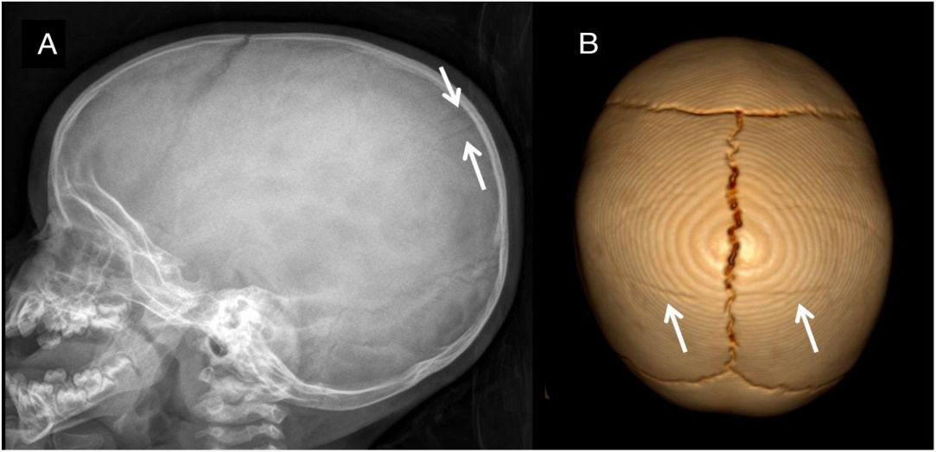
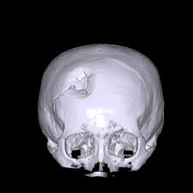
Classification of Skull Fractures
Linear Skull Fracture:
Simple crack in the bone without displacement.
Common in low-impact injuries.
Depressed Skull Fracture:
Fragment of bone is pushed inward, causing depression into the brain tissue.
Can cause brain contusion or hematoma.

Slide 62
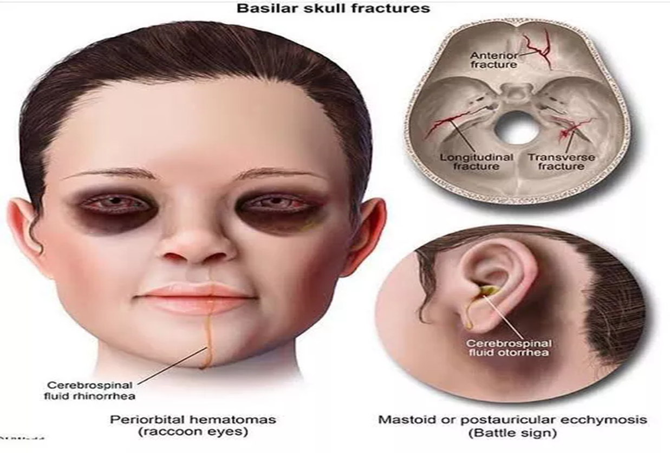
Cont…
3. Basilar Skull Fracture:
Occurs at the base of the skull (e.g., temporal or occipital bones).
May cause damage to brainstem or cranial nerves.
Associated with CSF leaks (cerebrospinal fluid), leading to rhinorrhea or otorrhea.

Slide 63
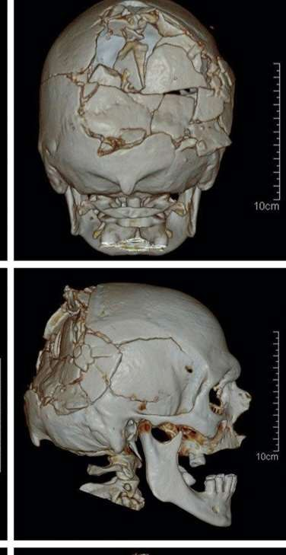
Cont..
4. Comminuted Skull Fracture:
Bone is shattered into multiple fragments.
High-energy trauma typically causes this type

Slide 64
Symptoms of Skull Fractures
Headache: Often the first symptom of a skull fracture, ranging from mild to severe.
Loss of Consciousness: May occur depending on the severity of the trauma (may be brief or prolonged).
Neurological Deficits:
Confusion, disorientation, or memory loss.
Focal neurological signs (e.g., hemiparesis, aphasia, vision problems).
Signs of Increased ICP:
Vomiting, nausea, bradycardia, and hypertension.
Pupillary changes (e.g., dilated or unequal pupils).

Slide 65
Cont..
Cranial Nerve Signs (particularly with basilar skull fractures):
Rhinorrhea or otorrhea (CSF leaking from the nose or ear).
Hemotympanum (blood in the middle ear).
Battle's sign (bruising behind the ears).
Raccoon eyes (periorbital ecchymosis).
Seizures: May occur, particularly if the fracture is near the cortex.
Bleeding: Scalp lacerations, subgaleal hematomas, or ear/nose bleeding.

Slide 66
Indications for Surgery in Skull Fractures
Surgical intervention may be required to relieve brain compression, repair CSF leaks, or repair broken skull bones.
Depressed Fractures:
If the bone is depressed inward causing brain injury or contusion.
Fracture depth > 1 cm, or if there is neurological deterioration.
Open Skull Fractures:
If there is a laceration over the fracture with exposed bone or brain tissue.
Immediate surgical debridement and infection control are required.

Slide 67
Cont..
Basilar Skull Fracture:
If associated with CSF leakage (rhinorrhea, otorrhea), or cranial nerve injury.
Surgery may be necessary for persistent CSF leaks or complications (e.g., meningitis).
Comminuted Fractures:
Multiple fracture fragments causing significant risk for brain injury, increased ICP, or infection.

Slide 68
Cont..
Increased Intracranial Pressure (ICP):
Surgery may be required if the fracture is causing significant brain compression, hematomas, or ICP elevation.
Consider decompression (e.g., craniectomy or craniotomy).
Neurological Deterioration:
Progressive deterioration in GCS or worsening neurological status (hemiparesis, aphasia, etc.).
Surgical exploration to assess for brain contusions, intracranial hemorrhage, or hematomas.

Slide 69
Surgical Considerations
Timing of Surgery:
Early surgical intervention is recommended for depressed fractures, open skull fractures, or when there is a risk of brain herniation.
Delay may be necessary in comatose patients to assess neurological stability first.
Techniques:
Craniotomy or Craniectomy: Removal of part of the skull to evacuate hematomas, repair fractures, or reduce brain swelling.
Debridement and wound closure: For open fractures, to prevent infection and repair the scalp laceration.

Slide 70
Cont..
ICP Management:
ICP monitoring if there are signs of increased brain swelling or hemorrhage.
Use of osmotic agents (e.g., mannitol) and sedation to reduce ICP.
Antibiotics:
Prophylactic antibiotics for open skull fractures to prevent meningitis or brain abscesses.
Neuroimaging:
CT scan or MRI for assessing the extent of brain injury, fracture pattern, and associated hemorrhage.

Slide 71
Secondary Brain Injury
Secondary brain injury refers to the series of pathophysiological events that occur in the brain after the initial traumatic insult (primary brain injury).
Unlike primary brain injury, which is caused by the direct mechanical damage (e.g., contusion, laceration, skull fracture)
secondary brain injury involves processes that lead to further neuronal damage, cerebral edema, increased intracranial pressure (ICP), and ischemia.

Slide 72
Causes of Secondary Brain Injury
Ischemia (Hypoperfusion):
Reduced cerebral blood flow due to hypotension, vasospasm, or cerebral vasodilation.
Leads to neuronal death and worsens neurological function.
Cerebral Edema:
Swelling of brain tissue caused by increased permeability of the blood-brain barrier (BBB).
Results in elevated intracranial pressure (ICP), causing further neuronal injury due to compression.

Slide 73
Cont..
Increased Intracranial Pressure (ICP):
As the brain swells or bleeds, ICP increases, leading to brain herniation or reduced perfusion.
High ICP reduces cerebral perfusion pressure (CPP), leading to ischemia
Inflammatory Response:
Microglial activation and cytokine release trigger inflammation, causing neuronal injury and disruption of the blood-brain barrier (BBB).

Slide 74
Cont..
Excitotoxicity:
Excessive release of neurotransmitters (e.g., glutamate) leads to calcium overload in neurons, causing cellular injury, oxidative stress, and neuronal death.
Oxidative Stress:
Free radicals and reactive oxygen species (ROS) are produced in response to injury and contribute to cellular damage and inflammation.
Coagulopathy:
Trauma or other injuries may lead to disseminated intravascular coagulation (DIC) or impaired clotting, worsening bleeding and edema in the brain.

Slide 75
Cont..
Hyperthermia:
Elevated body temperature increases metabolic demand and worsens cerebral injury by promoting inflammation, oxidative stress, and cerebral vasodilation.
Hypoxia and Hypercapnia:
Hypoxia (low oxygen levels) or hypercapnia (elevated CO2 levels) worsen brain injury by causing cerebral vasodilation and decreased oxygen delivery to the brain.

Slide 76
Clinical Features of Secondary Brain Injury
Increased Intracranial Pressure (ICP):
Headache, vomiting, papilledema (swelling of optic disc), altered mental status, and Cushing’s reflex (hypertension, bradycardia, irregular breathing).
Neurological Deterioration:
Progressive confusion, drowsiness, or coma.
Worsening focal deficits (e.g., hemiparesis, aphasia).
Seizures:
Occur due to electrical disturbances in the brain.

Slide 77
Cont..
Cerebral Edema:
Increased brain volume causes herniation, with possible brainstem compression.
Autonomic Dysregulation:
Fluctuating blood pressure, heart rate abnormalities, or respiratory dysfunction due to brainstem involvement

Slide 78
Prevention and Management of Secondary Brain Injury
1. Early Recognition and Monitoring:
Neurological monitoring: GCS and ICP monitorng
Imaging: CT scan or MRI to identify hemorrhage, edema, and structural damage.
2. Optimizing Cerebral Perfusion:
Maintain CPP (Cerebral Perfusion Pressure):
Aim for a CPP of 60-70 mmHg.
Fluid resuscitation and vasopressors (e.g., norepinephrine) for hypotension.

Slide 79
Cont..
Control ICP:
Elevate head of bed to 30-45 degrees to facilitate venous drainage.
Sedation and analgesia to minimize agitation and avoid increases in ICP.
Osmotic therapy (e.g., mannitol) or hypertonic saline to reduce cerebral edema.
Ventilatory support to maintain normocapnia (normal CO2 levels).

Slide 80
Cont..
3. Prevention of Hypoxia and Hypercapnia:
Maintain oxygenation: Target PaO2 > 60 mmHg to prevent hypoxia.
Avoid hypercapnia (PaCO2 > 45 mmHg), which increases cerebral blood flow and ICP.
4. Seizure Management:
Prophylactic anticonvulsants: In patients with significant brain injury or those with cortical fractures.
Phenytoin or levetiracetam may be used in the acute setting.

Slide 81
Cont..
5. Temperature Control:
Normothermia: Maintain normothermia (36-37°C).
Hyperthermia (fever) increases metabolic demand, inflammation, and worsens injury.
6. Multimodal Sedation and Analgesia:
Use sedation to reduce ICP and prevent agitation.
Ensure adequate pain control without over-sedating or inducing hypotension.

Slide 82
Introduction to Increased ICP
Definition:
Increased ICP occurs when the pressure inside the cranial vault exceeds normal limits, typically >20 mmHg.
It is a critical condition that can lead to cerebral ischemia, brain herniation, and death if not managed promptly.
Normal ICP:
Normal ICP: 5–15 mmHg in adults.
Controlled by a dynamic balance of the brain tissue, cerebrospinal fluid (CSF), and blood volume.

Slide 83
Cont..
Components of ICP
ICP is the sum of the pressure exerted by three components within the cranial vault:
Brain Tissue (80%)
The parenchymal tissue, neurons, glia, and extracellular matrix.
Cerebrospinal Fluid (CSF) (10%)
Fluid contained in the ventricles and subarachnoid space.
Blood Volume (10%)
The blood within the cerebral vessels (arteries, veins, and capillaries).

Slide 84
Monro-Kellie Doctrine
Monro-Kellie Doctrine:
The total volume inside the rigid skull is fixed. If the volume of one component (brain, CSF, or blood) increases, the volume of another must decrease to compensate, or ICP will rise.
The skull is a closed system:
Brain expansion → displacement of CSF and/or blood.
Increase in blood volume → reduction in CSF volume and/or brain tissue compression.

Slide 85
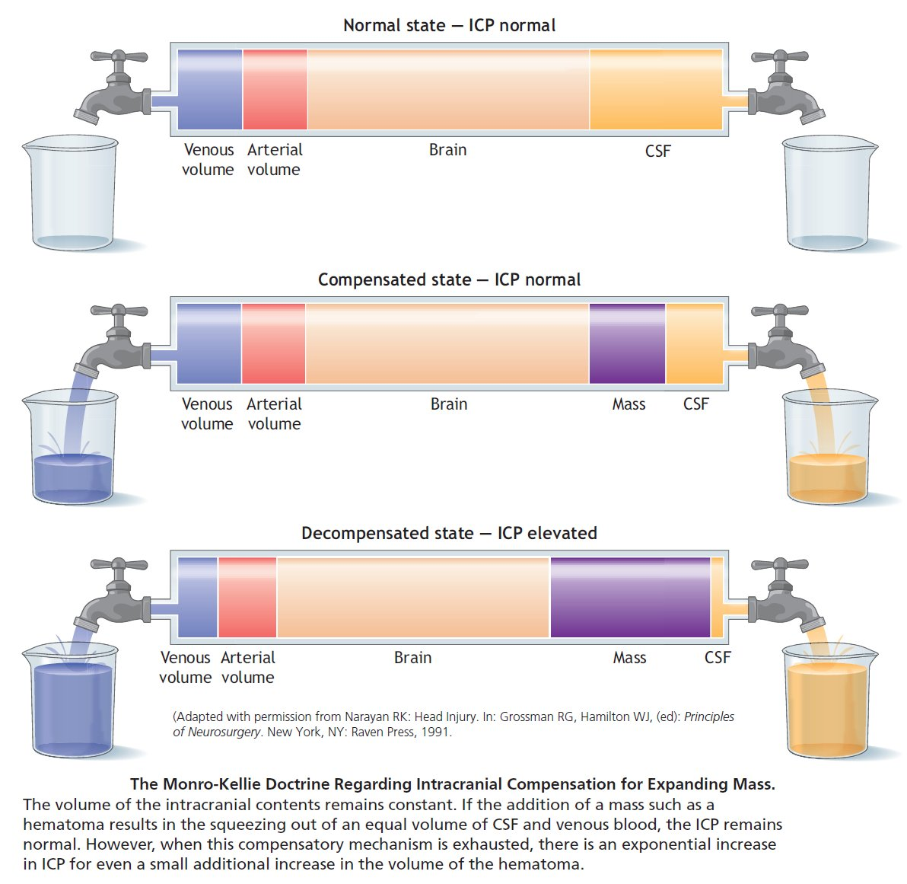

Slide 86
Mechanisms of Increased ICP
Brain Edema
Increased CSF Volume:
Obstructive Hydrocephalus: Blockage in the CSF pathways (e.g., in the ventricles or subarachnoid space).
Overproduction of CSF due to conditions like choroid plexus tumors.
Increased Blood Volume:
Cerebral Vasodilation: Increased blood flow into the brain due to hypoxia, hypercapnia, or increased metabolic demand.
Venous Obstruction: Impaired venous drainage from the brain, e.g., due to venous sinus thrombosis.

Slide 87
Complications of Increased ICP
Brain Herniation:
Herniation results in brainstem compression, leading to cardiovascular instability, respiratory failure, and death.
Hypoxia and Ischemia:
Increased ICP impairs blood flow to the brain, leading to hypoxia, brain death, and irreversible damage.
Permanent Neurological Damage:
Severe ICP elevation can cause irreversible brain damage or death.

Slide 88
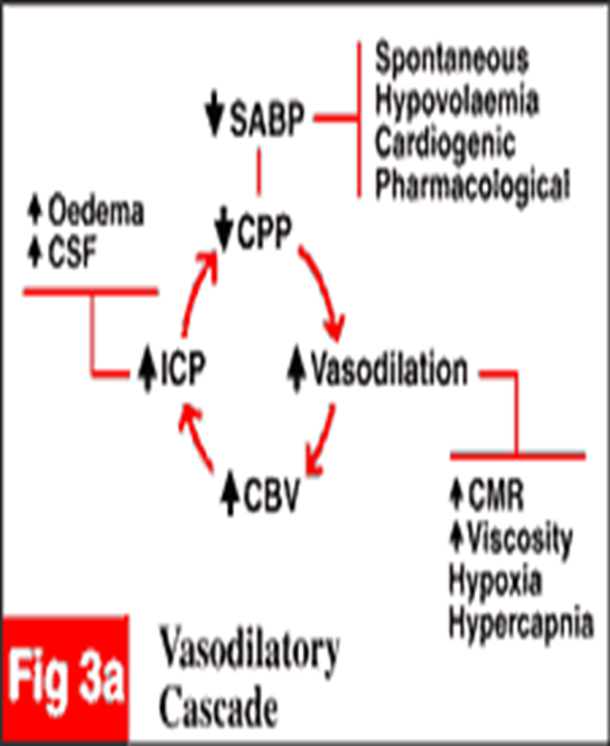
Factors increases ICP
Increase in PaCO2
Seizures
Fever
Hypoxia
Obstructed venous return
Pain
Coughing/straining against ETT
Volatile anesthetic gases?
Nitrous oxide
Ketamine
Antihypertensive- nitropruside, hydralazine / Ca-chanel blocker

Slide 89
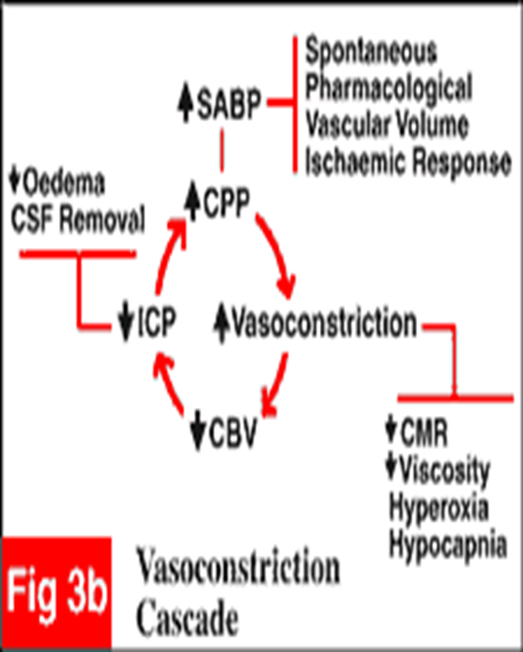
Factors that decreases ICP
Decrease in PaCO2
Barbiturates, Propofol
Mannitol
Hypertonic saline (3-7%)
Hypothermia
Surgical decompression

Slide 90
Clinical Manifestations of Increased ICP
Early Symptoms:
Headache: Often described as worsening in the morning.
Nausea and Vomiting: Due to brainstem compression or increased ICP.
Altered Mental Status: Confusion, lethargy, or irritability.
Papilledema: Swelling of the optic disc due to increased venous pressure.

Slide 91
Cont..
Advanced Symptoms:
Bradycardia: As part of the Cushing Reflex (hypertension, bradycardia, and irregular respirations).
Hypertension: Increased systemic BP to maintain cerebral perfusion.
Fixed and Dilated Pupils: Compression of the oculomotor nerve (CN III).
Abnormal Respiratory Patterns: Cheyne-Stokes or biot's respirations due to brainstem involvement.

Slide 92
Cont..
Severe Symptoms:
Decreased GCS: Rapid deterioration in the Glasgow Coma Scale.
Seizures: Due to increased brain irritability.
Coma: Complete loss of consciousness, potentially leading to brain death.

Slide 93
Management of Increased ICP
1. Monitoring ICP:
ICP monitoring is critical in patients with suspected increased ICP (e.g., intracranial pressure bolt, ventriculostomy).
It is essential for detecting secondary brain injury due to ischemia, edema, or hemorrhage
Intraventricular catheter (ventriculostomy)Allows for direct ICP measurement and CSF drainage (therapeutic).
Subdural or epidural

Slide 94
Cont..
2. Head Elevation
Goal: Promote venous drainage from the brain to decrease ICP.
Positioning:
Elevate head of the bed to 30–45 degrees to help reduce venous congestion in the brain and facilitate CSF drainage.
Avoid neck flexion and head rotation, which can compromise venous return.
Considerations: Avoid excessive elevation in hypotensive patients to prevent reduced cerebral perfusion pressure (CPP).

Slide 95
Cont..
3. Osmotic Therapy
Mannitol:
Mechanism: Osmotic diuretic that reduces cerebral edema by drawing fluid from the brain into the vasculature.
Dosage: Typically 0.25–1g/kg IV bolus.
Side Effects: Hypotension, hypokalemia, kidney injury, and rebound cerebral edema if used excessively.
Hypertonic Saline: (3% saline)
Mechanism: by creating an osmotic gradient that draws water out of the brain tissue into the vascular space.

Slide 96
Cont..
Dosage: Administered as a bolus (usually 250–500 mL of 3% saline).
Side Effects: Hypernatremia, renal dysfunction, and pulmonary edema. Monitor electrolytes closely.
Indications for Osmotic Therapy:
Marked cerebral edema or signs of brain herniation.
Elevated ICP that is refractory to initial management strategies.

Slide 97
Cont..
4. Sedation and Analgesia
Pain and agitation increase systemic blood pressure, which raises ICP.
Sedation reduces sympathetic stimulation, decreases metabolic demand, and helps maintain control of ICP.
Medications:
Propofol or etiomidate for sedation. These agents have cerebral-protective properties, as they decrease cerebral metabolic rate.
Fentanyl or morphine for analgesia.

Slide 98
Cont..
Use low-dose benzodiazepines (e.g., midazolam) to reduce anxiety or agitation.
Considerations:
Avoid deep sedation that may mask signs of neurological deterioration.
Monitor sedation depth and neurological status frequently, especially in ICU settings.

Slide 99
Cont…
5. Hyperventilation
Mechanism:
Hyperventilation lowers PaCO2, which causes cerebral vasoconstriction, reducing cerebral blood volume and consequently ICP.
This is a temporary measure to reduce ICP, as prolonged hyperventilation may lead to cerebral ischemia.
Indications:
Short-term use (usually for <30 minutes) in cases of acute herniation or when other measures fail to control ICP.

Slide 100
Cont..
In patients with severe brain injury, hyperventilation may be used while awaiting surgical intervention.
Target CO2:
Aim for PaCO2 levels of 30–35 mmHg to induce mild vasoconstriction without risking excessive ischemia.
Caution:
Hyperventilation should be avoided for long periods in patients with closed-head injuries due to the risk of inducing ischemia.

Slide 101
Cont..
6. Surgical Intervention
Decompressive Craniectomy:
Indication: In cases where ICP remains elevated despite optimal medical management.
A craniectomy involves removing a portion of the skull to allow for brain expansion and reduce ICP.

Slide 102
Additional Supportive Measures
Fluid Management:
Isotonic fluids (e.g., normal saline) should be used to avoid overhydration, which can worsen edema.
Avoid hypotonic solutions or overresuscitation that can increase cerebral edema.
Antipyretics and Temperature Control:
Hyperthermia can worsen cerebral injury, so fever control is critical.
Use antipyretics or cooling techniques (e.g., cooling blankets) to maintain normothermia (36–37°C).

Slide 103
Cont..
Anticonvulsants:
Seizure prophylaxis may be indicated in patients with traumatic brain injury or those at risk for seizures.
Phenytoin or levetiracetam can be used to reduce the risk of secondary seizures that could exacerbate ICP.
Nutritional Support:
Early enteral nutrition is important for preventing metabolic derangements and maintaining brain function.
Ensure proper electrolyte balance and adequate caloric intake.

Slide 104
Additional Pharmacological Options
Barbiturate Coma (Last Resort):
Indications: Used in patients with refractory ICP that does not respond to first-line treatments.
Medications: High-dose barbiturates (e.g., pentobarbital) induce a medically induced coma, reducing brain metabolic activity and lowering ICP.
Calcium Channel Blockers:
Drugs like nimodipine may be used in the setting of traumatic brain injury or subarachnoid hemorrhage to prevent cerebral vasospasm, which could exacerbate ICP.

Slide 105
Reference
Harold Ellis: Anatomy for Anaesthetists (8th edition). Blackwell Science Ltd, 2004.
Paul G Barash: Handbook of Clinical Anesthesia (8th edition). Lippincott Williams & Wilkins publications, Inc., 2016.
Ronald D. Miller: Millers Anesthesia (9th edition). Churchill Livingstone publication, An 157 Imprint of Elsevier, 2009.158

